Slide 1

CEIR Product/Platform - Training Manual

Slide 2

Product/Platform Overview
About CEIR
Use Case
Stakeholder Overview
Feature Overview
Deployment Architecture
Integration Touch Points

Slide 3
Product Overview
Key objective and functionality of CEIR is to block (or maintain black listing for blocking and grey listing for monitoring) the devices in multi operator’s environment homogeneously without any preference or selection for multiple reasons or objectives from using the network services like voice, SMS, GSM data(not Wi-Fi data).
CEIR systems are also used for synchronizing the multiple EIRs from multiple network Operators in a country.
The only basis of blocking the device is IMEI / ESN / MEID of the device
There are scenarios where a local EIR in Operator’s environment or Central EIR at CEIR authority can take precedence to execute or trigger the user data collection and barring action. It is completely a case depends on country, regulation and law.

Slide 4
Blocking of Device ??? Why it is required to be done

Slide 5
Use Case
Active GSM Devices OR imported GSM devices personally by end customer which have not paid taxes or have pending TAX liability
Include both new handset and second hand handset
In stock devices with retailer / distributors
Device bought but not in use (in-active) ( in used only in specific conditions)
Lost or Stolen devices locally and internationally
Substandard Devices (IMEI) which are not following GSMA standard or failed IMEI validation algorithm and may cause service, quality or health related issues
/Null/All 0’s IMEI devices which possibly also impact the network, end user of device or environment and create issue with LI (Lawful interception) based on IMEI as such devices cannot be tracked
Locked GSM devices for a country or network for foreign country and unlocked illegally in local market
Active devices registered in the name of illegal immigrants ex. expired visa or no visa (Security)

Slide 6


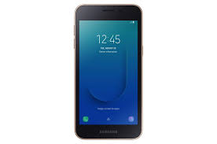



Key Issue Addressed
Counterfeit Phones
Manufacturer loss $
No warrantee
Safety Issues
Poor Performance
Illegal Import
Government Taxation
Loss $
Un-level playing field
For legitimate device
providers
Phones Theft
Consumer loss $
Personal Injury
Buying stolen good
Insurance claims
Insurance fraud
Subscription Fraud
Operator Loss $

Slide 7
Blocking of Devices ? All ? Any Exception

Slide 8
Exception List
VVIP List
Roamer using local network SIM card with grace period / active visa period
Guest roamers with foreign SIM
Registered Devices under grace period
Devices that on WiFi usage and does not use cellular network

Slide 9
IMEI - Definition
IMEI Stands for International Mobile Equipment Identity
Every mobile device that connects to cellular network has unique IMEI
This include cell phones, smartphones, cellular enabled tablets, smart watches, and other devices that support cellular data
IMEI numbers are produced by manufacturers
GSMA stands for an international organization that oversees network operators.
IMEI is 15 digit long number
14 digit unique number
8 digit TAC number – allocated by GSMA
6 digit serial number – allocated by manufacturers
Maximum 1 million devices
Each brand/model will have same TAC
1 digit Check Digit
Luhn’s Algorithm to validate IMEI number
IMEISV
14 digit IMEI number
2 digit Software Version
Will change after software update
Dial *#06# to know your IMEI

Slide 10
IMEI - Categorization
Whitelisted to be allowed to be used in country and access network
International Mobile Equipment Identity
Valid IMEI:
TAC Approved
Taxes Paid
VIP List
White
List
IMEI
In-Valid IMEI:
Non Tax Paid
Stolen Device
Not allowed to be used due to regulation in country
Zero or NULL IMEI
Grey List
Grey Listed to be allowed to be used in country for specific duration **
Black
List
Black list NOT to be allowed to be used in country
10

Slide 11



Typical Architecture
All Operator WorldWide Specific
Data
CEIR
DB
All Country Operator Specific
Data
DB
Once all DB are synced, then the all DB are same and have the same copy
Secured Public Access Network
Operator Network
Operator Network
Operator Network
DB
DB
Operator Specific
Data
DB
EIR
EIR
EIR

Slide 12





Device Management Control System
Customs
Rules
Industry/
Importers
DMC (Regulator)
Set of Guidelines/Process
Market / End User
DB
Illegal Market

Slide 13
Stakeholder Overview

Slide 14
Stakeholder Overview - Contd

Slide 15
Stakeholder - Feature Overview

Slide 16
Stakeholder - Feature Overview

Slide 17
Platform – Architecture
Manufacturer
Industry/
Importers
Customs
Retailer/Distributor
End User
(Local/Expat/Foreigner)
Law Agency/Immigration/TRC/Operator
TAC
Allocation Process
HTTPS
CEIR (Hosted in DMC IT Network)
SMS/Payment Gateway Network
Secured API
Web Client
SMS Interface
DB
HTTP
Set of Process(One set of each User Type)
Secure
HTTP
Interface
Set of GSMA
Process
DB
Set of
Operator Process
HTTPs/FTP
Interface
…
Operator ‘s Network
DB
DB
HTTPs
FTP/HTTPs
Device Physical Flow
Device Logical Flow

Slide 18
Platform – Features
Product Features
Consignment
Stock
Grievance
User Management
Register Device
Visa Update
Stolen and
Recovery
Block and Unblock
Grey List
Black
List
Register
User
Configuration
Management
Anonymous
Stock
Upload
Check IMEI
Policy
And Rules
GSMA
Integration
SMS Integration
Payment
Integration
ETL Integration
Audit
Management
SLA
Management
Alert Management
Reporting
Customer
Care
Interface

Slide 19





Platform – Integration
Email Server
CEIR System
SMTP
Operator IT Network
DMC IT Network
HTTPS
HTTP
Customer Care
SMS Server
MSC /SGSN
Server
Agent-based Interface
PRTG Server
Public Network
HTTPs
HTTPS
HTTPS
Payment GW
Users*
HTTPS
FTP
GSMA
Mediation
Server
Collector
Server
OTA Server
Users*: Importers, Customs, Police, Dealer, NID Register, Immigration Department, TRC, Company Registration Department

Slide 20
Platform – Integration
ETL for Operator CDR via FTP
Bulk SMS Aggregator for sending SMS over HTTP
Email Server for sending e-mails over SMTP
PRTG for alerts over ssh based interface
GSMA over HTTP(s) for global blacklist/TAC details
Payment Gateway for Device Activation Fee over HTTPs

Slide 21
Logical Databases – Stakeholder Mapping

Slide 22
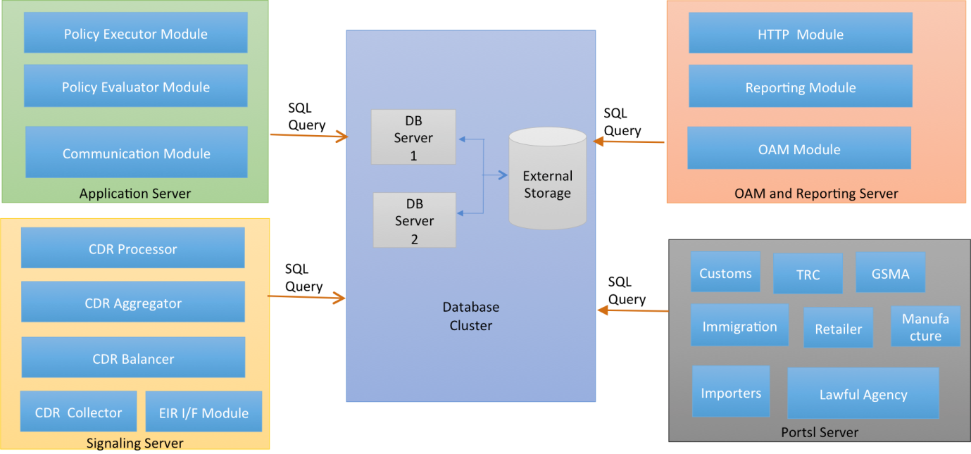
Deployment Architecture

Slide 23

Redundancy Architecture
Single IP between two servers called virtual IP
Each server has physical IP
Virtual IP is managed by Heart beat layer
Active / Standby Configuration
Virtual IP is on the active server
Heart Beat Layer

Slide 24
System Configuration
Two Phases
Grace (Phase I)
Post Grace (Phase II)
System Policy/Rules will be applied in post grace period.
Grace period is for building the system database
Each Policy will have a order and priority. If any policy execution fail, then the action would happen as per defined logic
Actions
System Regularized – The system regularize will be done in grace period, wherein all the devices will be allowed to operate in the network irrespective of policy violation
User Regularised – The User regularize is in post grace period, where the blocking/unblocking of device in network will depend on the user action against the policy violation notification
Blocked – The device usage has been restricted from use in the network
Allowed – The device usage is permitted for use in the network

